Slide 1
Java IO Streams

Slide 2
File Class
It does not specify how the information is retrieved from or stored in files.
Describe the properties of file
Used to obtain the information associated with the file such as permissions, time,date, path and so on.
Example
File f1=new File(“D:/sample.txt”);

Slide 3
What is IO Stream?
I/O Stream represents input source or output destination.
Stream can represent different kinds of sources and destinations, including disk files, devices, other programs, and memory arrays.
Streams support different kinds of data, including simple bytes, primitive data types, localized characters, and objects.
Some streams simply pass on data; others manipulate and transform the data in useful ways.
Stream is a sequence of data.
Program uses an input stream to read data from a source, one item at a time
Program uses an output stream to write data to a destination, one item at time

Slide 4
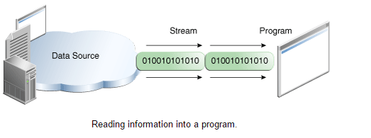
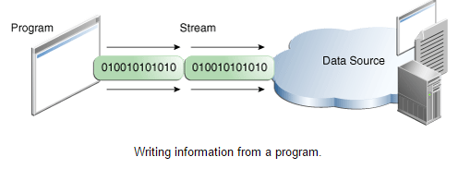
...Contd

Slide 5
Byte Streams
Java byte streams are used to perform input and output of 8-bit bytes.
All byte stream classes are descended from InputStream and OutputStream.
Though there are many classes related to byte streams but the most frequently used classes are, FileInputStream and FileOutputStream.

Slide 6
Copying the content of an input file into an output file
public class CopyFile {
public static void main(String args[]) throws IOException {
FileInputStream in = null; FileOutputStream out = null;
try {
in = new FileInputStream("input.txt");
out = new FileOutputStream("output.txt");
int c;
while ((c = in.read()) != -1) out.write(c);
} finally {
if (in != null) in.close();
if (out != null) out.close();
}
}
}
The finally block will execute whether or not an exception is thrown.
Output:
Contents of “input.txt” is copied to “output.txt”

Slide 7
ByteArrayInputStream class
This stream utilizes a byte array as the source
This class has two constructors
BufferedArrayInputStream(byte array[])
BufferedArrayInputStream(byte array[], int start, int numBytes)
Creates stream from a sub set of array
This stream implements both mark and reset functionalities

Slide 8
Example
Creating Streams
String tmp=“abcdefghijklmnopqrstuvwxyz”;
byte b[]=tmp.getBytes();
BufferedArrayInputStream in1 =new BufferedArrayInputStream(b);
BufferedArrayInputStream in2 =new BufferedArrayInputStream(b,0,5);
Reading from the stream
while(c=in.read()!=-1)
{
System.out.println((char) c);
}

Slide 9
ByteArrayIOutputStream class
Creating Streams
BufferedArrayInputStream out1 =new BufferedArrayInputStream(b);
Writing into the stream
String tmp=“abcdefghijklmnopqrstuvwxyz”;
byte b[]=tmp.getBytes();
out1.write(b);

Slide 10
Buffered IO Streams
Most of the examples we've seen so far use unbuffered I/O.
Each read or write request is handled directly by the underlying OS.
Makes the program much less efficient, since each such request often triggers disk access, network activity, or some other operation that is relatively expensive.
To reduce this kind of overhead, the Java platform implements buffered I/O streams.

Slide 11
…Contd
Buffered input streams read data from a memory area known as a buffer and the native input API is called only when the buffer is empty.
Similarly, buffered output streams write data to a buffer, and the native output API is called only when the buffer is full.
The following code converts an unbuffered stream into a buffered stream using the wrapping
Example
ByteArrayInputStream f=new ByteArrayInputStream(b);
BufferedInputStream in=new BufferedIputStream(f);

Slide 12
Example for mark and reset in Buffered Stream
Creation
BufferedInputStream in=new BufferedIputStream(f);
BufferedInputStream in=new BufferedIputStream(f, 100);
Input
String s=“This is a &copy; copyright symbol”+” But this is &copy not”;
byte b[]=s.getBytes();

Slide 13
…Contd
Output
This is a © copyright symbol But this is &copy not
How do we mark?
f.mark(32), where f is the buffered stream
Marks next 32 bytes read
How do we reset?
f.reset()

Slide 14
PushbackInputStream
Pushback is used on an input stream to allow a byte to be read and then returned to the stream
How do we create the stream?
ByteArrayInputStream f=new ByteArrayInputStream(b);
PushbackInputStream in=new
PushbackInputStream(f);

Slide 15
Example
Input
String s=“if (a==4) a=0;”
Output
If (a .eq. 4) a<-0;
Steps to implement
Get byte array from the string
Convert into pushback stream
Read the char by char
Print the character
If the character read is =, read another char to see ‘=‘ if so print == by .eq.
Otherwise print <- and return the char to the stream

Slide 16
DataInputStream & DataOutputStream
It enables the user to write or read primitive data to or from a stream
Creating Stream
DataOutputStream out;
out = new DataOutputStream(new FileOutputStream(“input.dat”);

Slide 17
…Contd
Writing into the stream
Out.writeDouble(10.9);
Out.writeInt(1000);
Out.writeBoolean(true);
Reading from the stream
DataInputStream in;
out = new DataInputStream(new FileInputStream(“input.dat”);

Slide 18
…contd
double d=in.readDouble();
int i=in.readInt();
boolean b=in.readBoolean();
System.out.println(“The values are:”+d+” “+ I +” “ +b);

Slide 19
Write a java program to get a file from the file system, read and copy its contents to another file using FileInputStream and FileOutputStream
Write a java program to read the “This is a &copy; copyright symbol”+” But this is &copy not” to display the output as This is a © copyright symbol But this is &copy not using the mark and reset corresponding to BufferedStream.
Write a java program to read the “if (a===b) a==0” to display the output as if(a .seq. b) a .eq. 0 using pushbackstream.
Write a java program to read a string which contains duplicate characters E.g. “bbbaccccnjj” and display only the unique characters “bacnj” using PushBack Stream
Write a java program to create a stream that contains Name, Age, Qualification Emaild, Score and write the stream to a file in the file system. Read the stream and print them in the console. (Use DataInputStream, DataOutputStream, FileInputStream and FileOutputStream )

